Slide 1
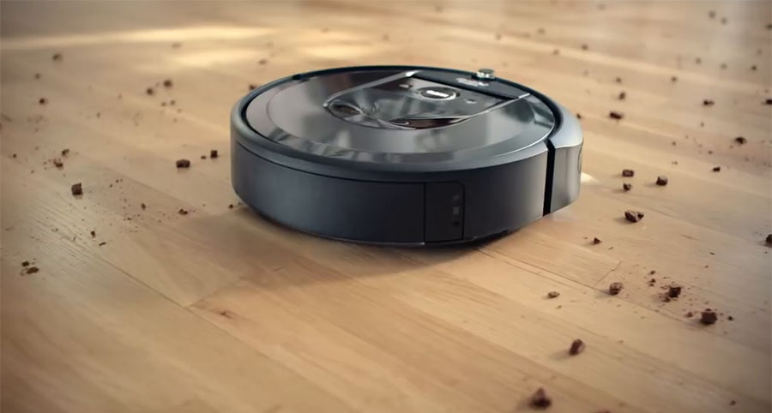
Actuators
Drive motors
Vacuum unit
Performance
Is the room clean?
Environment
Physical environment – a room
Sensors
Dirt sensor
Infrared sensors for walls/obstacles
Battery level
Dirt bin level

Slide 2
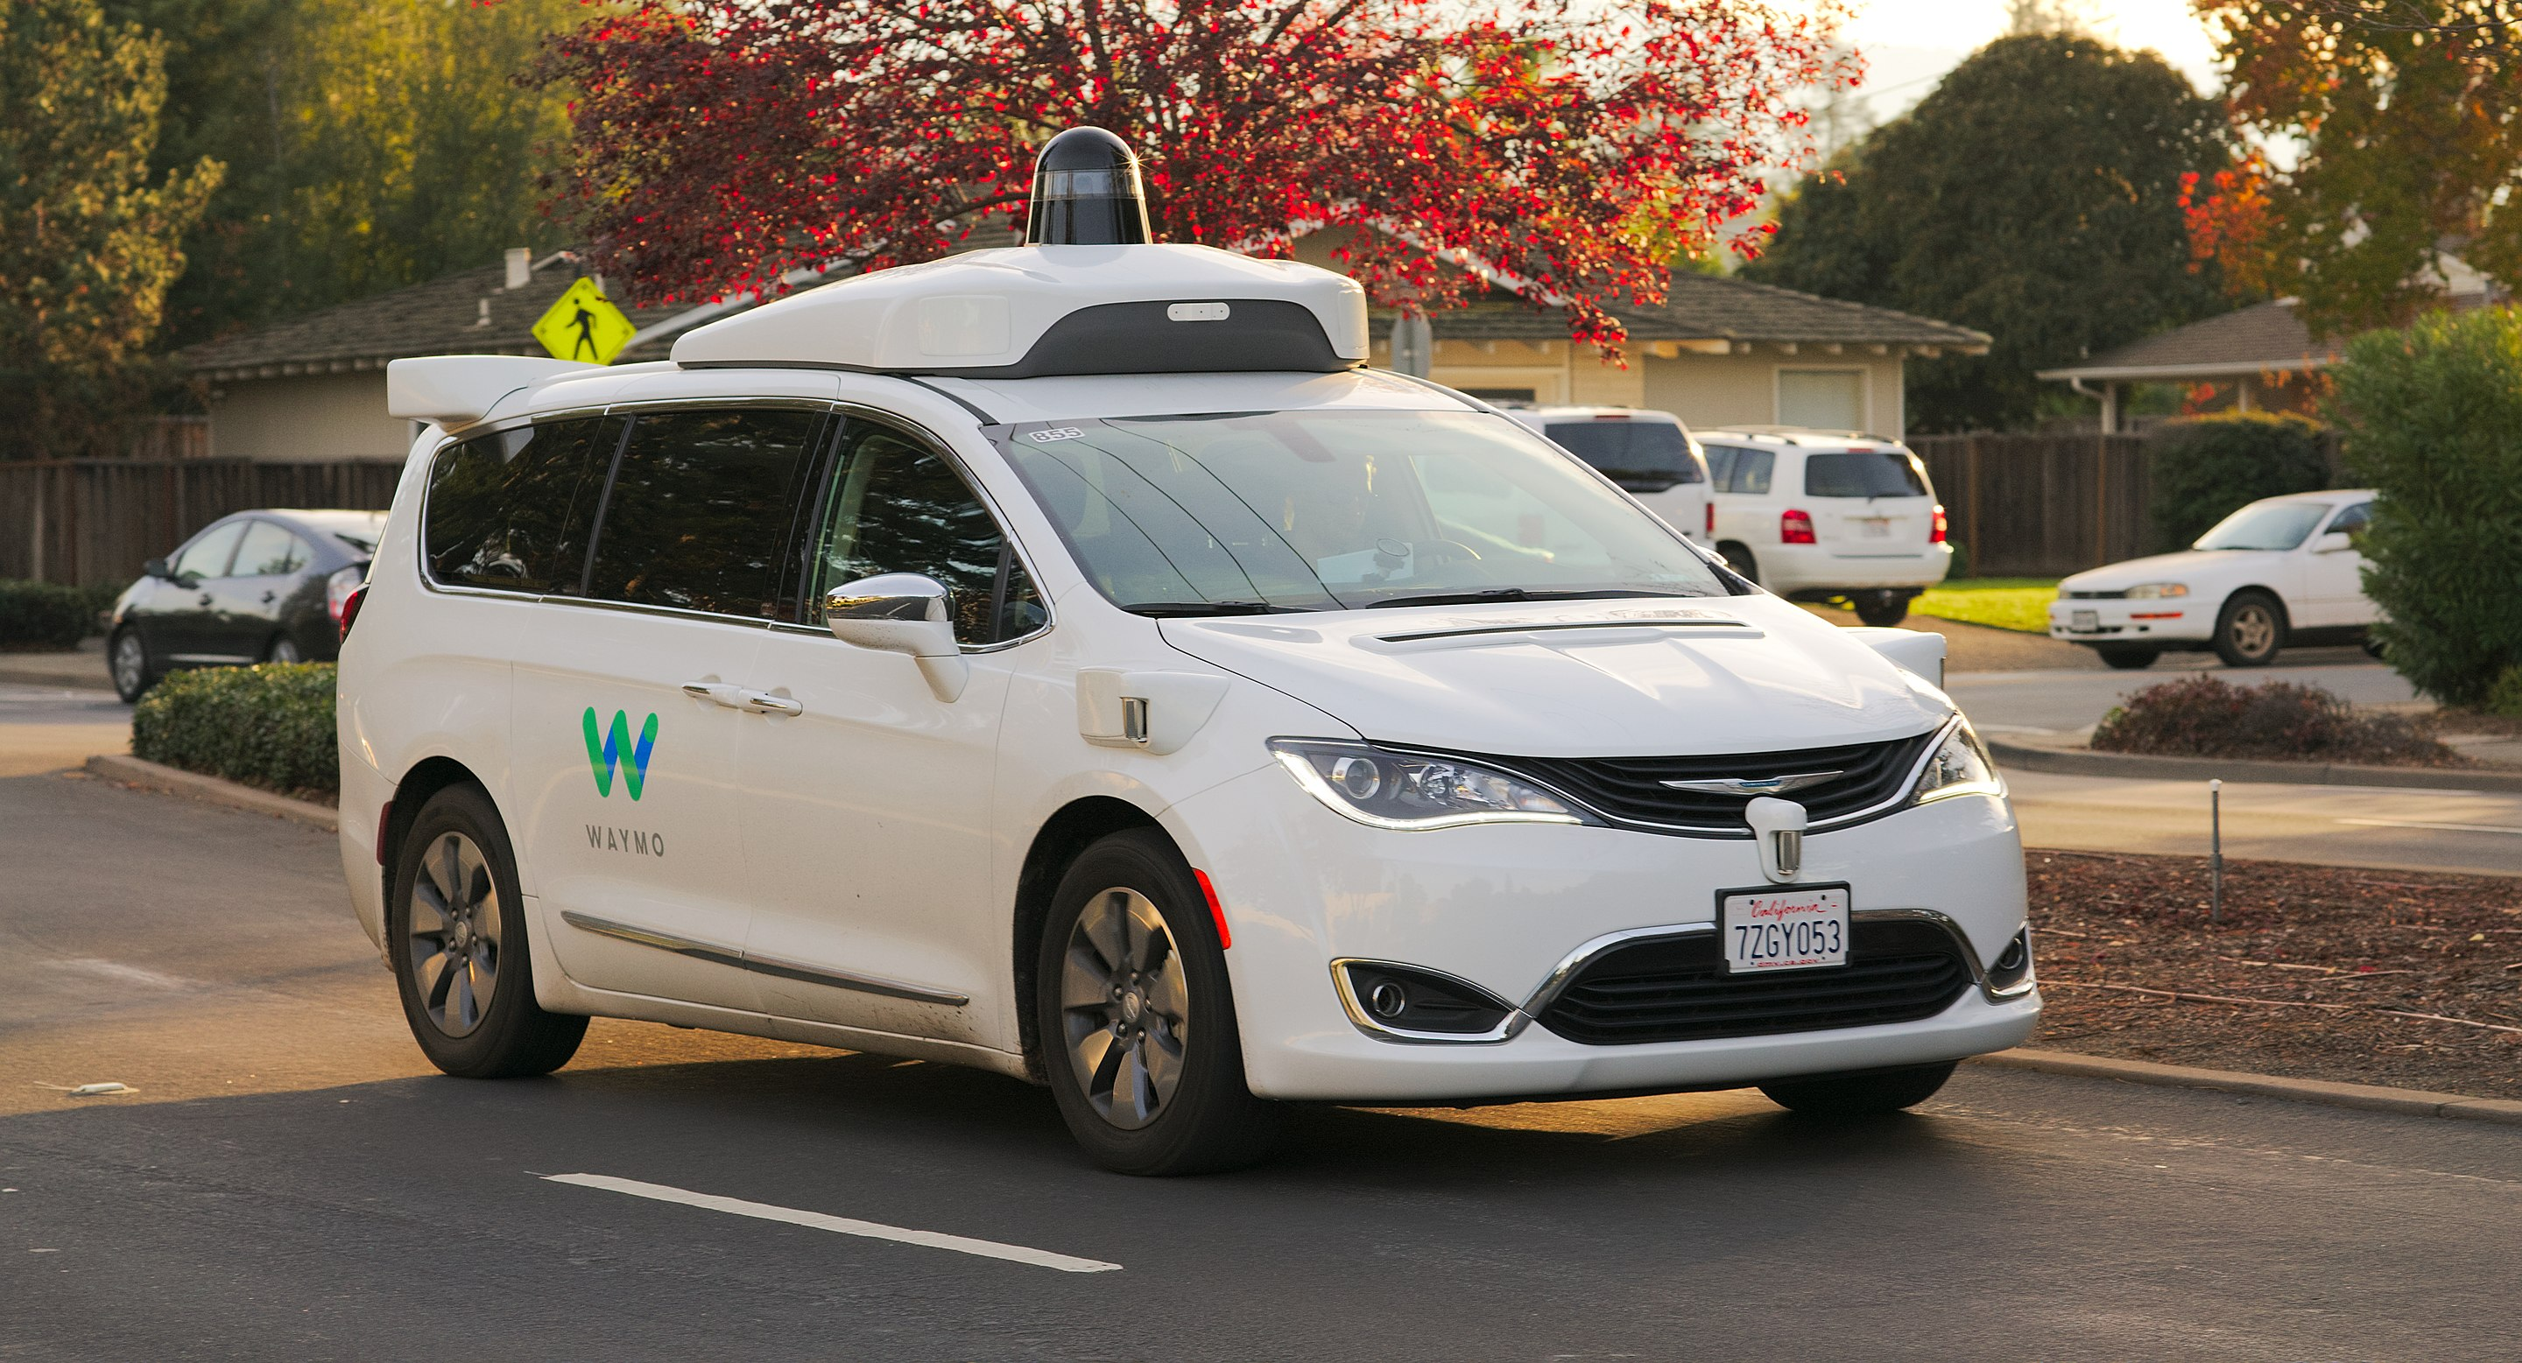
Performance
Reach the destination
Drive safely and legally
Actuators
Steering
Accelerator
Brake
Environment
Physical environment – road
Sensors
Camera
Infrared, radar, lidar, …
GPS

Slide 3

Performance
Perform customer service?
Pass the Turing test?
Actuators
Send text message
Environment
Instant messaging app
Sensors
Receive text message

Slide 4
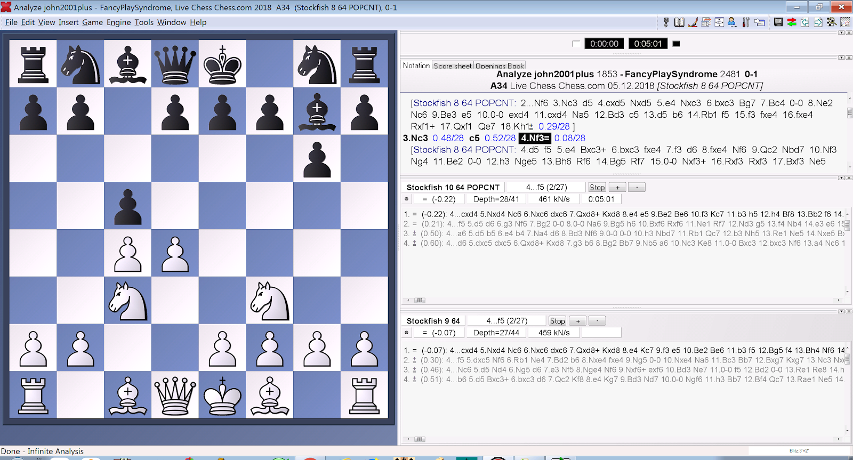
Performance
Win the game
Actuators
Make a move
Environment
Chess board
Sensors
Board state

Slide 5
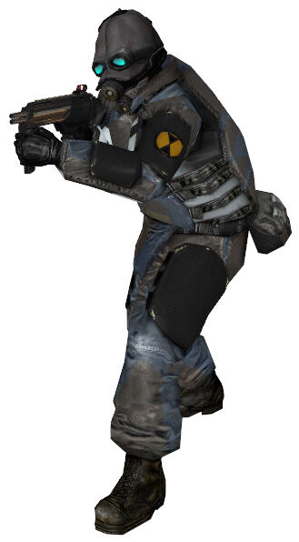
Performance
Kill the player?
Provide convincing behaviour?
Actuators
CharacterController.Move()
Shooting
Playing animations
Sensors
Raycasts
Player / NPC positions
Level geometry
Environment
Game world

Slide 6

Performance
????
Actuators
Muscles
Vocal cords
Sensors
Eyes
Ears
Nose
Tongue
Skin
Environment
Real world

Slide 7
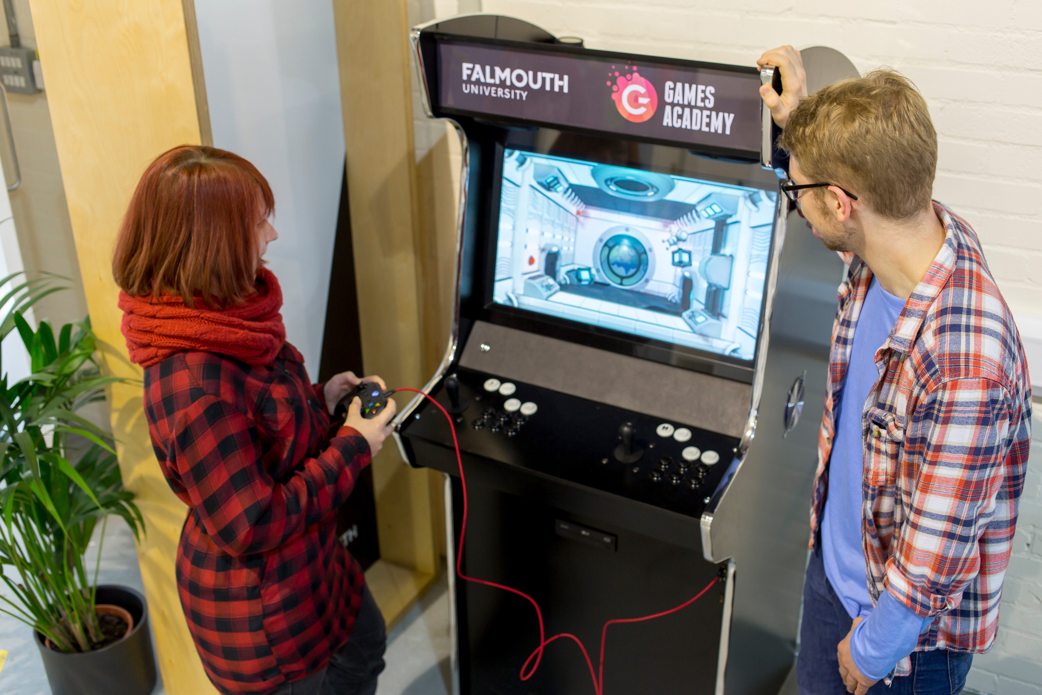
Performance
Win the game?
Have fun?
Actuators
Controller inputs
Sensors
Graphics
Sound
Haptic feedback
Environment
Game world

Slide 8
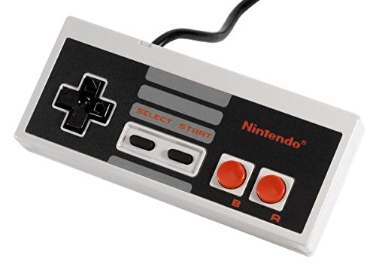
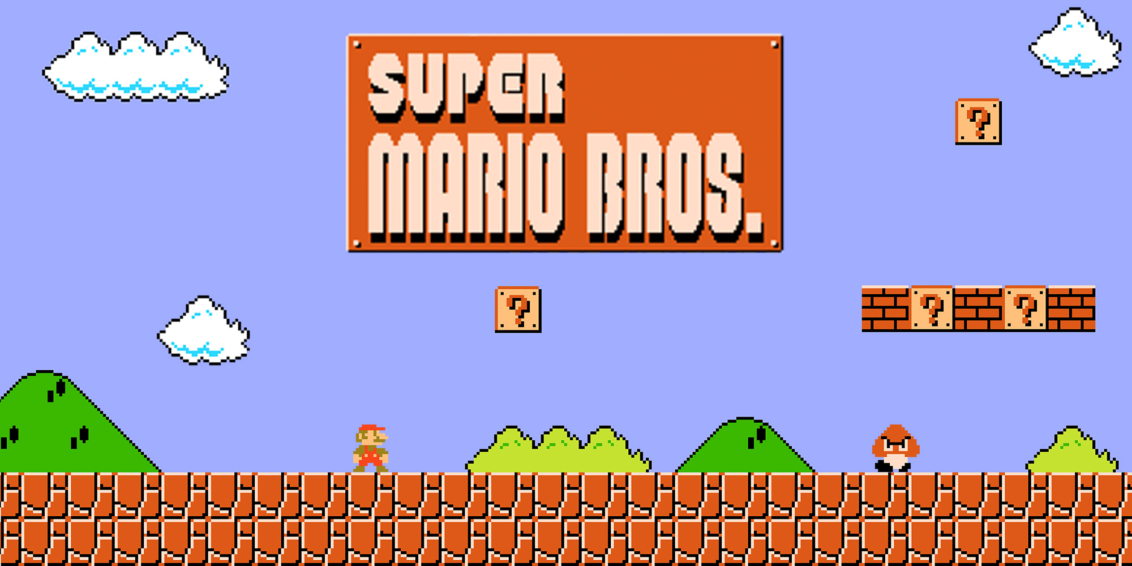
Actuators
Move left/right
Jump
Sprint
Crouch
Shoot fireball
Performance
Reach the end of the level
Environment
Game world
Sensors
Position of ground, enemies, coins, …

Slide 9
Sensing the world
A common way for game agents to sense the world is using raycasts
Cast a ray (straight line) from the agent out into the world
Test if the ray hits a collider
Unity: Physics.Raycast (for 3D), Physics2D.Raycast (for 2D)

Slide 10
Distance
Direction
Origin
Layer mask

Slide 11
Implementing AI to play Mario
Fork and clone the sample project (link on LearningSpace)
Load the Main Menu scene
Formulate an AI controller as a set of if-then rules
Code your AI logic into the Update method on the AIMarioController.cs script
Let’s see whose Mario can get the furthest!

